Slide 1
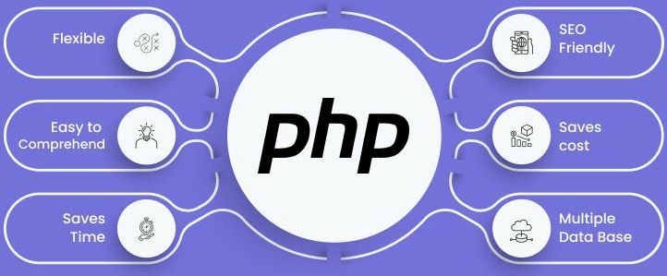

Slide 2
About today…
HTML + PHP + MySQL
Live Query Execution

Slide 3


Slide 4
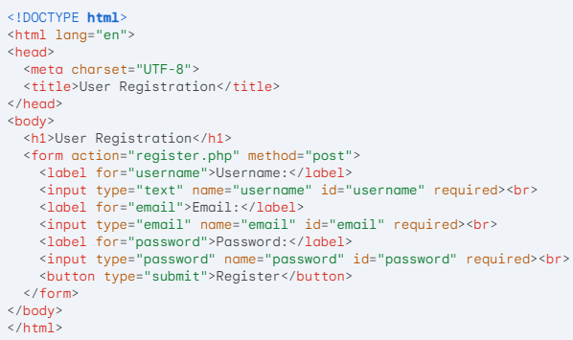
register.html
HTML Page (Insert)

Slide 5
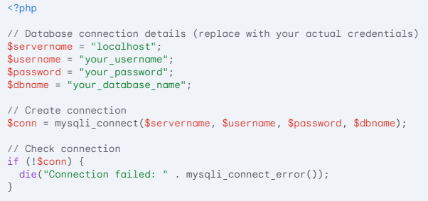
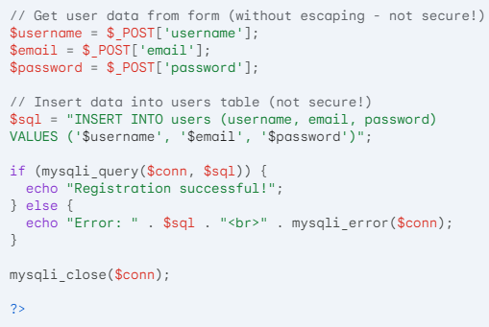
PHP Page (Insert)
register.php

Slide 6


Slide 7




READ DATA
1
2
4
3

Slide 8


Slide 9

UPDATE DATA
1
2
4
3

Slide 10


Slide 11

DELETE DATA
1
2
4
3

Slide 12


Slide 13

Which statement is used to Create a new record in a MySQL database table?
What is the query to store data in the database?
What are the parameters necessary to connect to database?
What are the query to get data from database?

Slide 14

Task 1
Create a database and relevant webpages (HTML+PHP ) for CRUD operations

